Slide 1

ML and Data Analytics on New York City Taxi and Limousine Data
Submitted By :
Harsh Raval (801257980)
Pranjali Mehta (801255574)
Shruti Nagpure (801256223)
Urvashi Murari (801205124)
Zubin Ladwa (801256671)

Slide 2
About Dataset
We have considered the year 2016 data from NYC-TLC dataset.
Overall we had 55 million entries.
In each trip record dataset, one row represents a single trip made by a TLC-licensed vehicle.
There are three kinds of trips for which we had the data.
Yellow, Green and FHV taxi trip records include fields capturing pick-up and drop-off dates/times, pick-up and drop-off locations, trip distances, itemized fares, rate types, payment types, and driver-reported passenger counts.
Notes:
This dataset contains 55 million entries. For this project, the dataset we have considered from the NYC-TLC dataset is from year 2016. In each trip record dataset, one row represents a single trip made by a TLC-licensed vehicle. There are three kinds of trips for which we have the data : Yellow taxis (New York City's medallion taxis), Green taxis (street hail livery taxis), FHV (For-Hire Vehicle). The yellow and green taxi trip records include fields like capturing pick-up and drop-off dates/times, pick-up and drop-off locations, trip distances, itemized fares, rate types, payment types, and driver-reported passenger counts. The FHV trip records include fields capturing the dispatching base license number and the pick-up date, time, and taxi zone location ID.

Slide 3
Problems Solved / Focus of the Project
With New York City Taxi and Limousine Dataset we have worked on:
Predicting Taxi Trip Duration
Predicting Taxi Fare
Visualization of Pickup Locations within New York City
Analyzing Trip Duration, Distance travelled, based on various parameters
Notes:
Distance tr : Vendors, trip duration, month,
Trip Duration: hour, weekday, month

Slide 4
AWS Services Used
AWS Glue : For loading the dataset from AWS S3 into Athena database after concatenating the data as required. .
AWS Athena : Utilised datastore services of Athena.
AWS Quicksight : For visualizations
AWS Sagemaker : For Building, Training and Analyzing ML models we utilized these services:
Sagemaker Notebook Instances
Sagemaker Training Jobs
Sagemaker Inference Endpoints
Notes:
We used AWS Glue Crawler to fetch the data from S3 to Glue database. We stored the data segregated for each kind of taxi under our “nycitytaxianalysis” database. After running the crawler we had tables like blog_yellow, blog_green, blog_fhv. We also created 3 glue jobs one for each taxi type. Each glue job appended the data from the csv files in s3 to a new Concatenated table which we created - ‘canonicaldata’. For Visualizations we used Quicksight and for building, training and analyzing ML models we used Sagemaker notebook instances, sagemaker training jobs and sagemaker Inference Endpoints.

Slide 5
Imbalance in our Dataset
The data set that we used had few biases.
It had many null and negative values.
Missing values were dropped as we had enough data to build model on.
We performed Random Sampling in Data Selection while splitting the data into training and testing set to avoid and treat presence of biases.
Various algorithms and strategies were implemented to train and optimize model performance.
Notes:
The data set that we used had few biases. Also it had many null and negative values for e.g.: The data that had Null value for fare amount hence it was dropped and trip distances that were negative were also dropped. Biases were removed by dropping the null values and having all values as float data.
For training the model we used a linear regression model, there were no assumptions that were made while selecting the model. In addition, we added an extra column called “Journey Time.”

Slide 6
Taxi Fare Prediction : Steps Involved
Used a Sagemaker Notebook instance of size t3.xlarge
Sagemaker Training Jobs were utilized to train the model and predict the Trip fare.
Shape of the training data : (1000000, 20)
Performed Data Analysis and Preprocessing 1. Creating Frequency Table 2. Visualizing the data using Histogram. 3. Dealing with missing values 4. Handling imbalance in data
Feature Engineering
Model Training and Saving
Setting up Hyperparameters for better predictions.
Utilizing Sagemaker Inference endpoint
Predicting Taxi Fare and comparing with Actual Values.
Notes:
Training the model
Before moving forward with creating models for fare prediction, we have to split our data into training, testing and validation sets. And to do so we create 3 separate csv files in our S3 bucket.
Once the S3 bucket is updated with these 3 files, we can then load all this data back into our sagemaker jupyter notebook instance and populate the same.
To load the files, “boto3” module has been used.
Following this we create Sagemaker training jobs for model training.
Since the task of predicting fare is very straightforward, we start by building a model using Linear Regression.
Based on the size of the input data, the time required to build a model for predicting fare may vary.
Once the model is built, it is required to save it using Sagemaker Inference Endpoint so that the trained model object can be used for predicting future taxi fares. To do so, “deploy()” method is used.
Finally, “predict()” method is used for predicting taxi fares on new data.

Slide 7
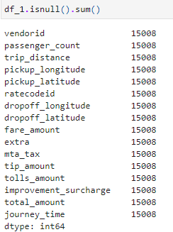
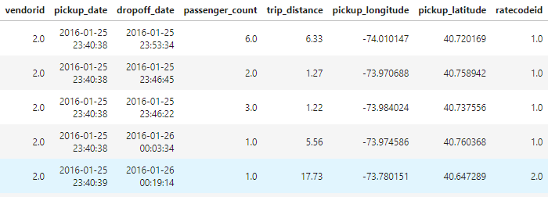
Understanding Data
Created a Sagemaker Notebook Instance of size t3.xlarge
Shape of the Data : (1000000, 20)
Data consists of both Categorical and Numerical Features
Target Variable : fare_amount
Some of the columns present in our data
Checking for Missing Values

Slide 8
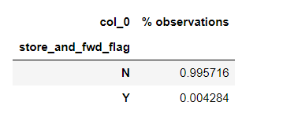
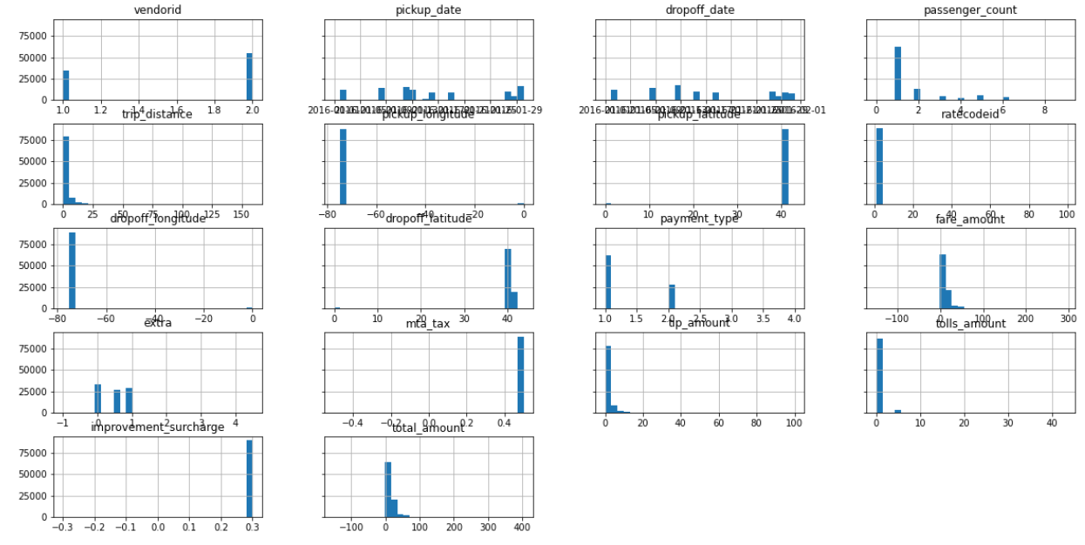
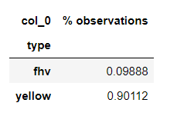
Data Analysis and Preprocessing
Frequency table : useful for understanding variance present in categorical features.
Visualizing numeric features : Histogram
Notes:
No Variance – More Bias – Sample of N (99%) - hence biased – removed by dropping column (store_and_fwd and type)

Slide 9
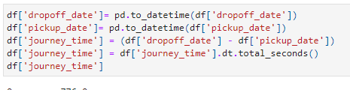
Featuring Engineering and Selection
Two features i.e. “pickup_date” and “dropoff_date” can be used to determine the ride length
New Feature : journey_time
Higher the ride length, more the fare amount.
Creating a new Feature
Removing columns which are not correlated to target variable : fare_amount
Updated Shape of the data : (849922, 16)

Slide 10
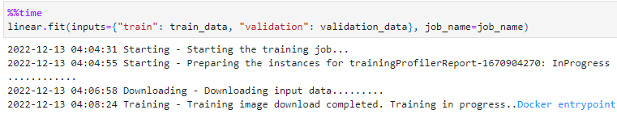
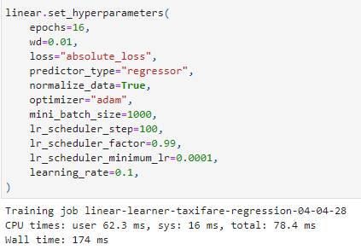
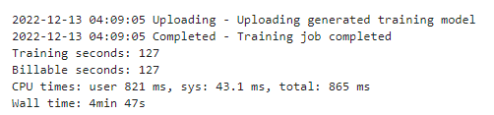
Training the model : Linear Regression with Hyperparameters
Developed three different sets viz. training set, validation set and test set.
Stored it in AWS S3 for future reference.
Triggered Sagemaker Training Job with Hyperparameters.
Training the Linear Model
Metrics used for evaluating model performance : Mean Absolute Error
Notes:
Training the model
Before moving forward with creating models for fare prediction, we have to split our data into training, testing and validation sets. And to do so we create 3 separate csv files in our S3 bucket.
Once the S3 bucket is updated with these 3 files, we can then load all this data back into our sagemaker jupyter notebook instance and populate the same.
To load the files, “boto3” module has been used.
Following this we create Sagemaker training jobs for model training.
Since the task of predicting fare is very straightforward, we start by building a model using Linear Regression.
Based on the size of the input data, the time required to build a model for predicting fare may vary.
Once the model is built, it is required to save it using Sagemaker Inference Endpoint so that the trained model object can be used for predicting future taxi fares. To do so, “deploy()” method is used.
Finally, “predict()” method is used for predicting taxi fares on new data.

Slide 11
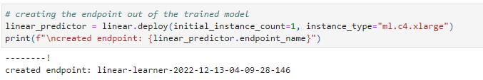
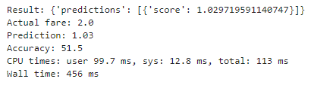
Predicting Taxi Fare
To create the endpoint of the trained Model, we used “deploy()” function. This serves the purpose of Sagemaker Inference Endpoint
Passing one row from test.csv into the predict function for Taxi Fare Prediction

Slide 12
Taxi Trip Duration Prediction : Steps Involved
Used a Sagemaker Notebook instance of size t3.xlarge
Triggered Sagemaker Training jobs to train the model for predicting the Trip Duration.
We used 1000000 rows from our dataset for this prediction.
Data Preprocessing and Additional Features
Univariate and Bivariate Analysis
Feature Engineering and Feature Selection
Model Training and Evaluation : We optimized our results by using different algorithms and tuning the features. Algorithms used:
Linear Regression
Random Forest
XgBoost
Observations

Slide 13
Adding new features and Data Preprocessing
We have added following new features to our dataset:
Trip_duration : Difference of pickup_time and dropoff_time
Calculated and assigned new columns to the data frame such as weekday, month and pickup_hour which helped us gain more insights from the data.
Data Preprocessing
Before performing analysis on our extracted dataset we performed following operations on the data:
Dummified all the categorical features.
Removed null values

Slide 14
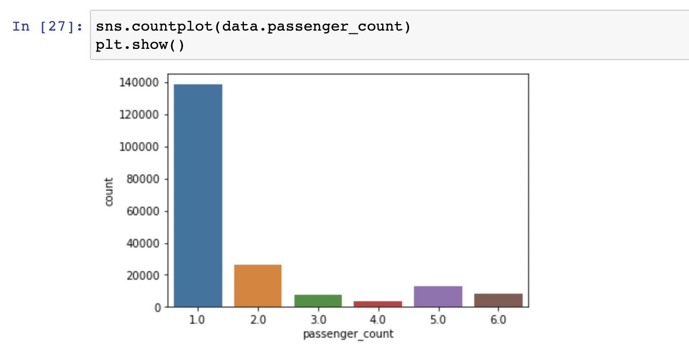
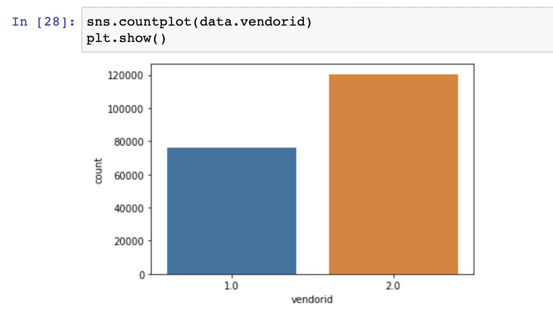
2. Univariate Analysis : This analysis helped us understand the pattern of data when only one variable was involved.
Passenger Count : From this plot we can infer that most of the trips were taken by single passenger.
Vendor ID: From this plot we can infer that only two vendors were involved.

Slide 15
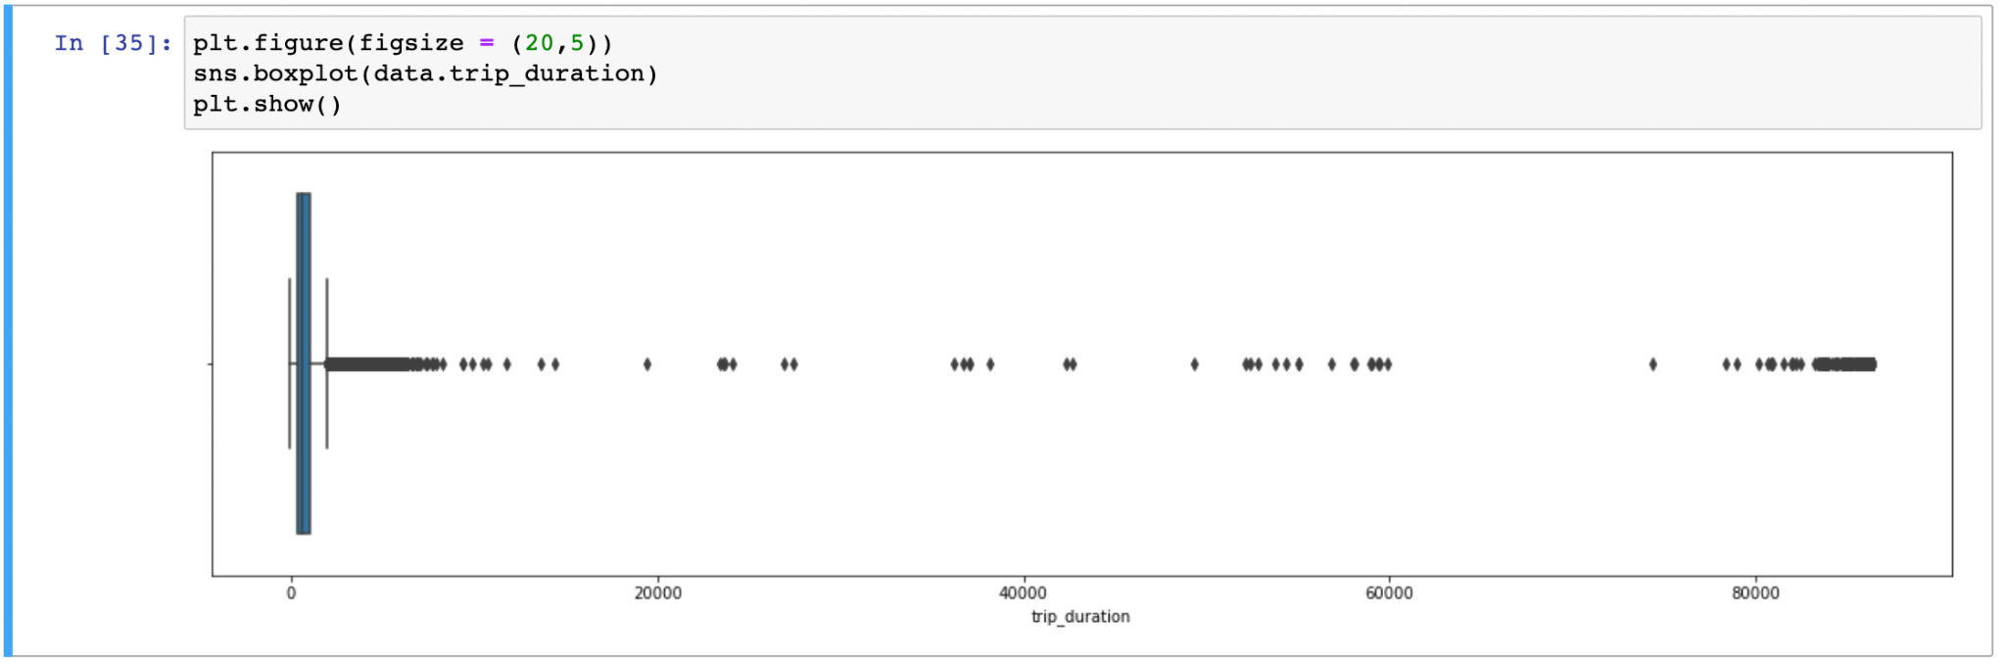
Trip Duration : From this plot of trip duration we can infer that there are some outliers present after over 200000 seconds which can affect the model performance and thus needs to be removed.

Slide 16
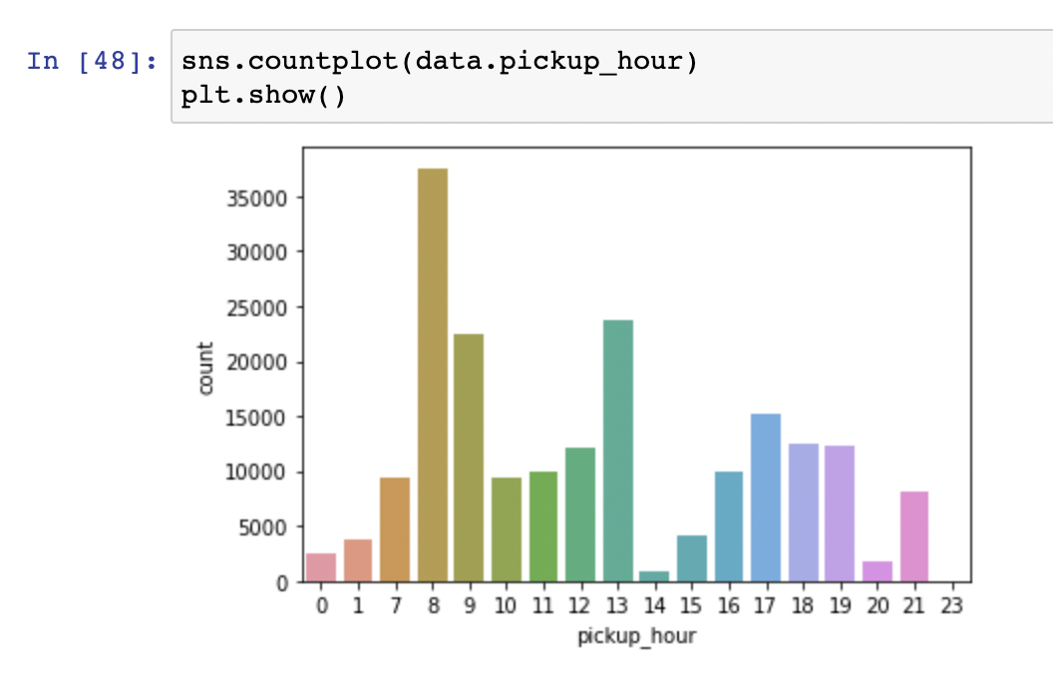
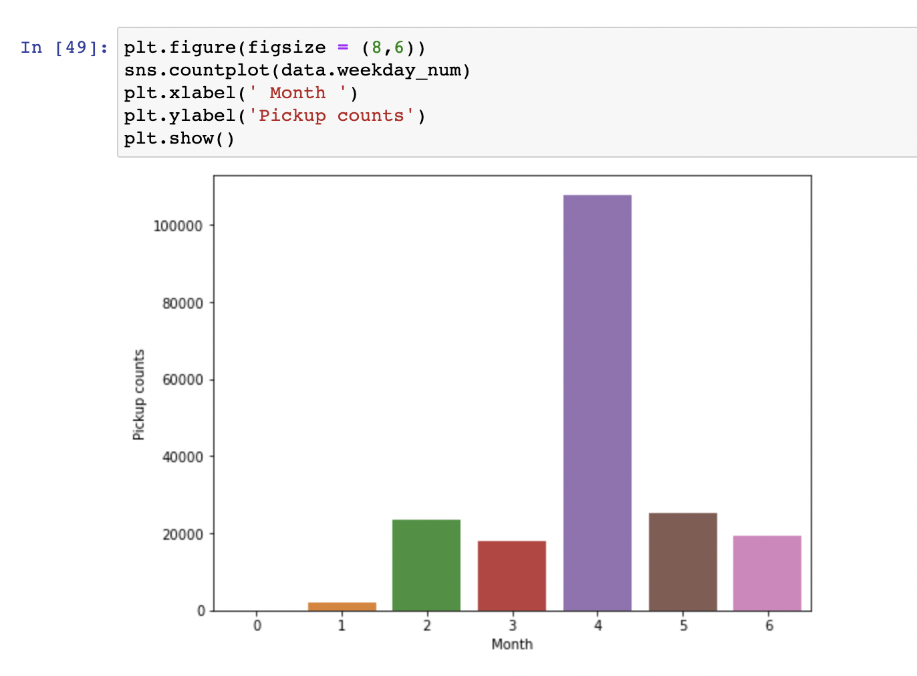
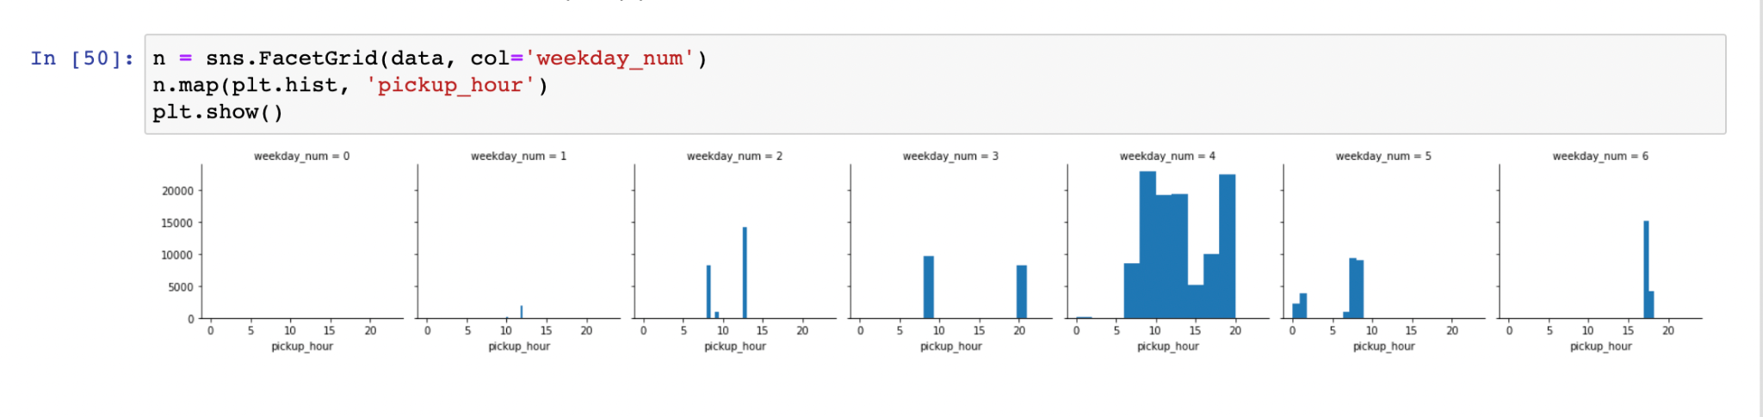
Total Trips per hour
Total Trips per Weekday
Hourwise Pickup Pattern across Week

Slide 17
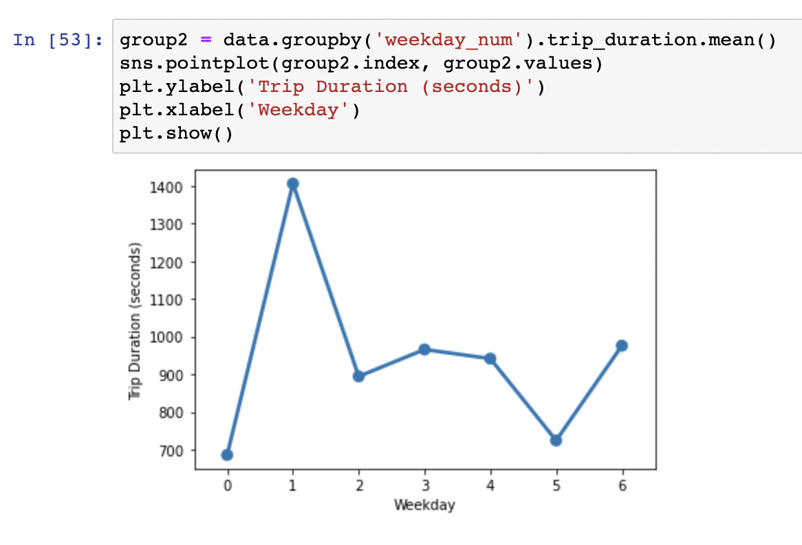
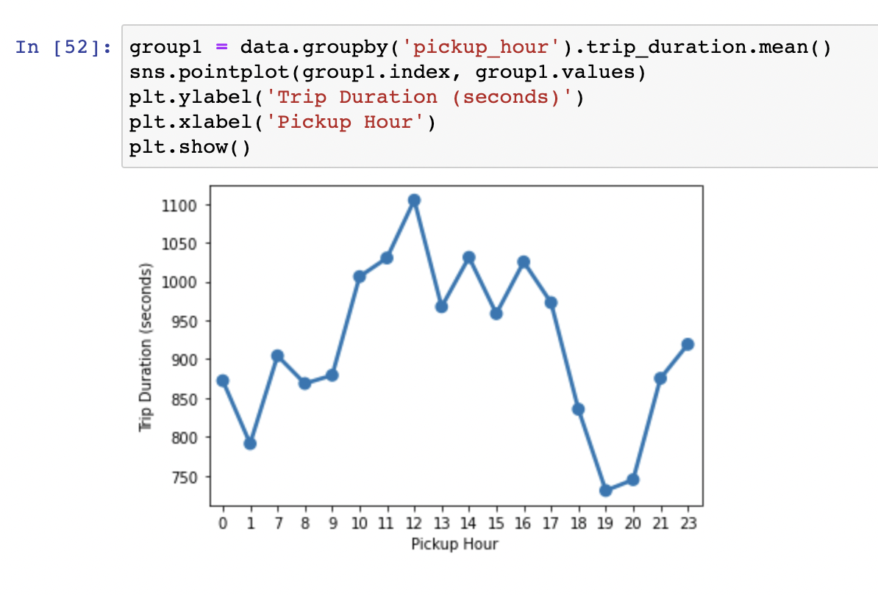
3. Bivariate Analysis : This analysis helped us understand the pattern of data when two variables were involved.
Trip Duration Per Hour : We concluded that Trip duration on an average was similar during early morning hours i.e. before 6 AM & late evening hours i.e. after 6 PM.
Trip Duration per Weekday : We concluded that Trip duration was highest on Mondays (Weekday 1).

Slide 18
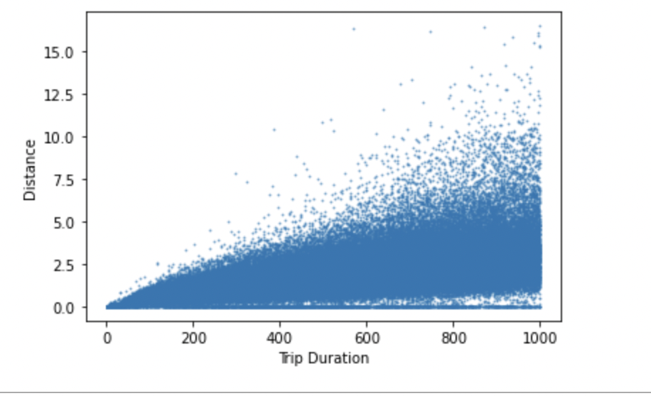
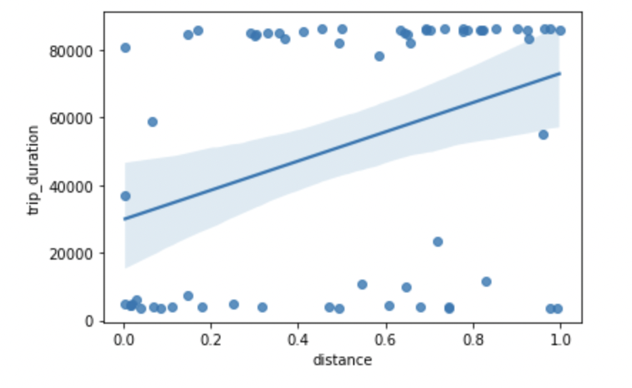
Distance Covered v/s Trip Duration : We can infer that there is a linear relationship between the distance covered and trip duration on an average but we can see dense collection of the trips in the lower right corner which showcase many trips with the inconsistent readings.
Trip Duration v/s Distance : There seems to be negligible correlation between these two metric as seen from the scatter plot where it should have been a linear distribution.

Slide 19
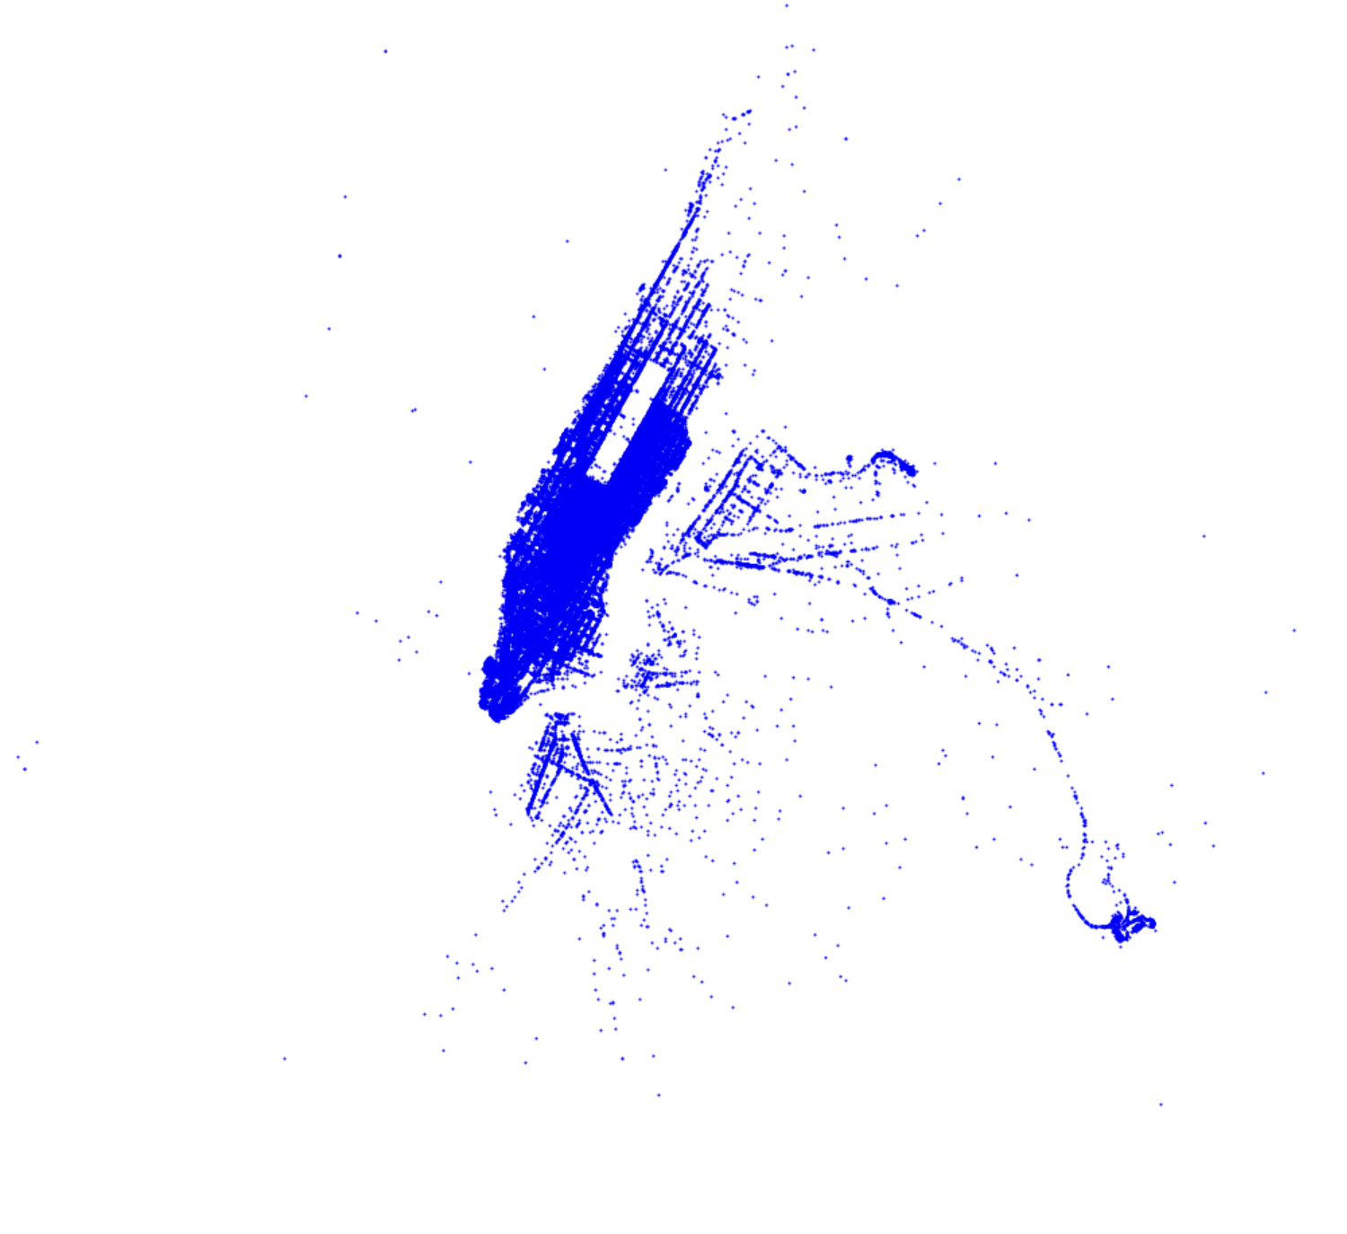
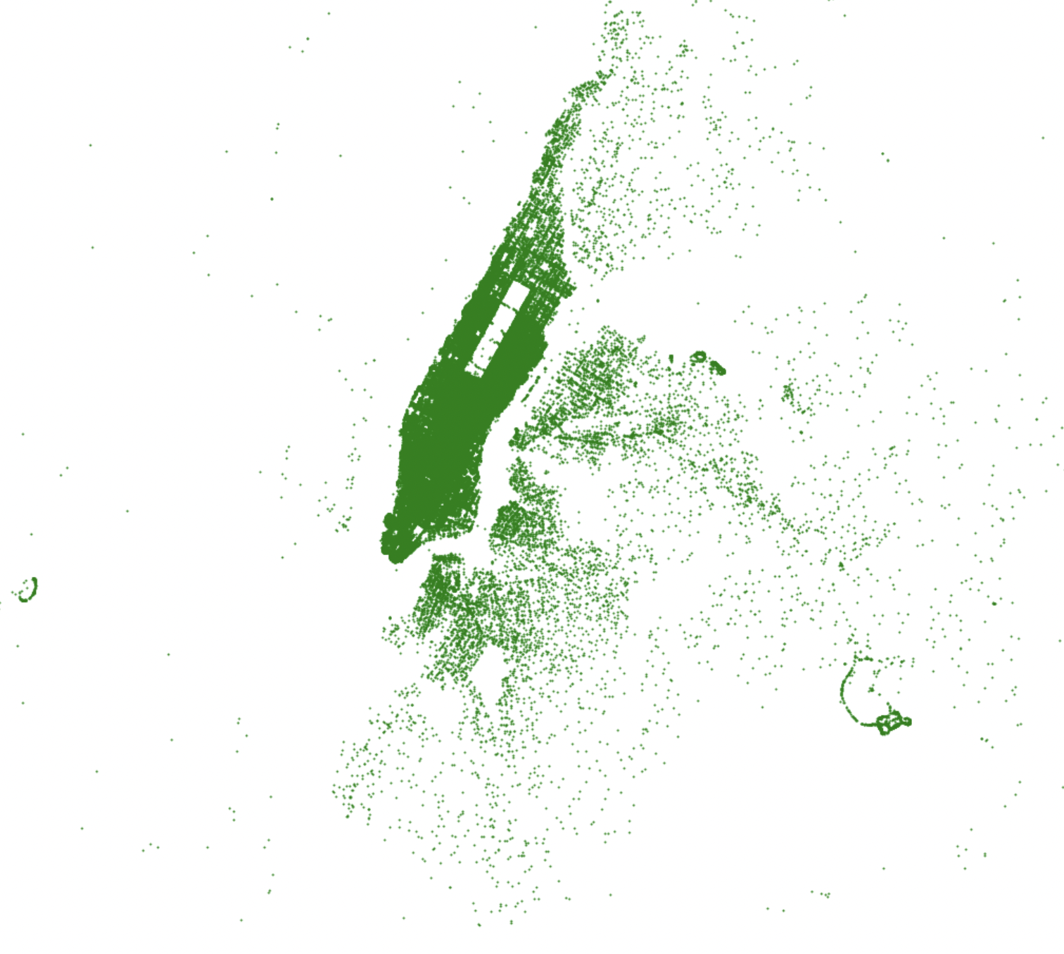
4. Visualizations : NYC Pickup and Dropoff
NYC Pickup Locations : We plotted the NYC Pickup area.
NYC Drop-off Locations : We plotted the NYC Drop off area.

Slide 20
5. Feature Engineering
We prepared our dataset after examining it from many angles before training our model. Given that our dataset only has a small number of dimensions. Instead of using the feature extraction approach, we will try feature selection first.
We will use backward elimination technique to select the best features to train our model
Like, It shows the p values for each feature as per its significance in the whole dataset.
It also shows the adjusted R squared values to identify whether removing or selecting the feature is beneficial or not.
After we assign X and Y values, we have assigned the variable “duration” to Y because that is the dependent variable and features such as id, timestamp and weekday were not assigned to X array because they are of type object and we need an array of float data type.
Once our feature set is ready for feature engineering we took the level of significance as 0.05 i.e. 5%. We rejected the feature from the list of array and re-run the model till p value for all the features went goes below .05 to find out the optimal combination for our model.
After the feature engineering we observed that we had 11 optimal features with each feature having p value < 0.05

Slide 21
5. Model Training and Evaluation
Linear Regression
Linear regression model is extremely fast to train on the high dimensional datasets consisting of even millions of records.
Observations:
The root mean squared value was very poor
The variance score was also very low
The feature selection and the feature extraction both groups resulted quite bad in prediction.
Random Forest
A random forest is a meta estimator that fits number of classifying decision trees on various sub-samples of the dataset and use averaging to improve the predictive accuracy and control over-fitting.
Observations :
There is approx. 200% improvement on the RMSE score for the Random forest regressor over the Linear regression of the feature selection group.
We received a good variance score of 1 on this model.
XGBoost
It is an optimized distributed gradient boosting library. It uses gradient boosting (GBM) framework at core.
Observations :
Significant improvement in the RMSE score for the tuned XGBoost regressor over the Random forest regressor.
RMSE score on the raw data and feature selected data are same, which disproves the theory that it is always better to select the relevant features which are statistically important.

Slide 22
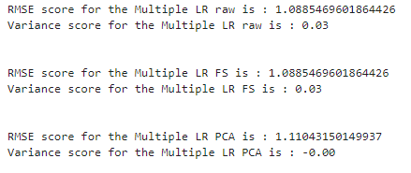
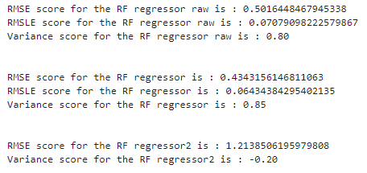
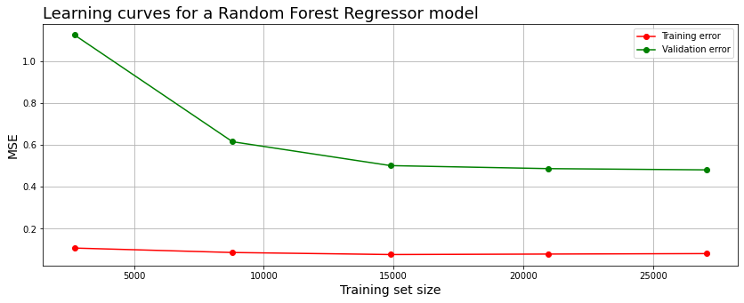
Linear Regression Results:
Random Forest Results:

Slide 23
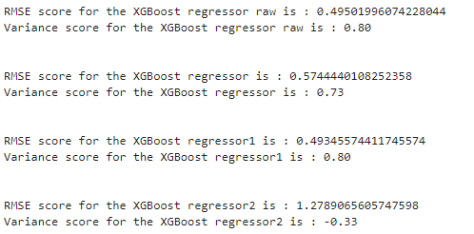
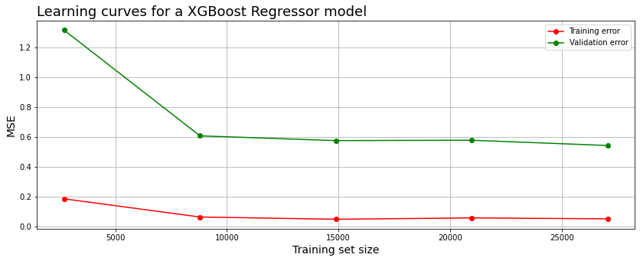
XgBoost Results:

Slide 24
Observations
We can observe that both the models shows somewhat similar learning rate but with visible differences in error rates.
Random Forest training curve initially starts high but later on improves as the training size increases and then seems to plateaued by the end.
XGBoost training curve on the other hand starts quite low and further improves with the increase in the training size and it too plateau towards the end.
Validation curve seems to show similar trend in both the models i.e. starts very high but improves with the training size with some differences in error rate i.e. XGBoost curve learning is quite fast and more accurate as compared to the Random Forest one.
Both the models seems to suffer from high variance since the training curve error is very less in both the models.
The large gap at the end also indicates that the model suffers from quite a low bias i.e. overfitting the training data.

Slide 25
Optimization and Conclusion
After training our data on the 3 models we came to the following conclusions:
XGBoost proved to be much more efficient in predicting the output. But it takes much more time to train it over the large dataset with more complexity as compared to the RF and Linear regression model but less time then the SVR.
It didn't helped us much to generalize the model by tuning hyper parameters for the RF model as there is not much difference in the RMSE scores of the default model and the tuned model of the feature selection group in fact both varies on every iteration and sometimes the tuned model gives poor results than the default model.
Contrast to the Random Forest regressor, XGBoost regressor prediction results were consistent on every iteration.
Feature extraction didn't helped in anyway to improve the RMSE score with any of the regression models.

Slide 26
Future Scope
It would be wonderful to supply a dataset to a GPU instance to make the training task more faster.
We can also trigger Sagemaker Training jobs on larger processing instances.
We can work on better Outliers detection in the future.
We can utilize Clusters in AWS and make a cluster for "normal" data and another for “non-normal” data.

Slide 27
THANK YOU!

